Slide 1
Chapter 9 Gauss Elimination

Slide 2
Chapter Objectives
Understanding how to implement forward elimination and back substitution as in Gauss elimination.
Recognizing how the banded structure of a tridiagonal system can be exploited to obtain extremely efficient solutions.

Slide 3
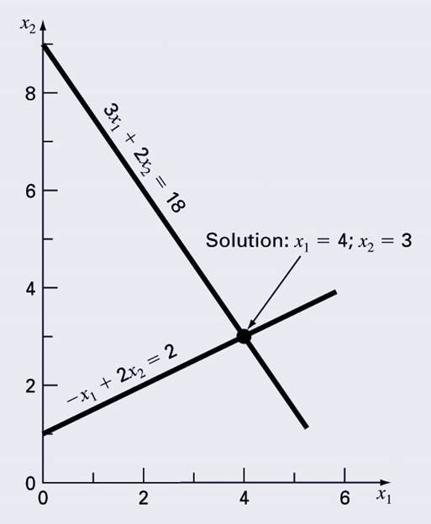
Graphical Method, 1
For small sets of simultaneous equations, graphing them and determining the location of the intercept provides a solution.

Slide 4
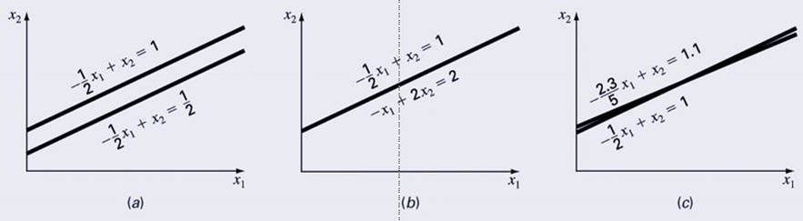
Graphical Method, 2
Graphing the equations can also show systems where:
No solution exists
Infinite solutions exist
System is ill-conditioned
ILL-CONDITIONED
SINGULAR

Slide 5
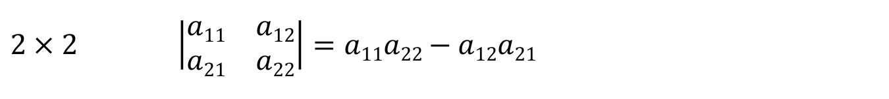
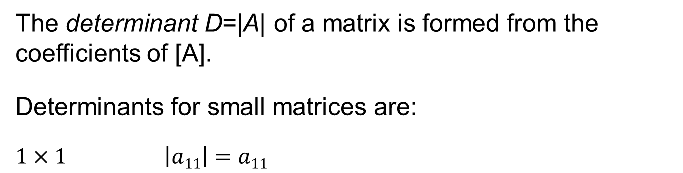
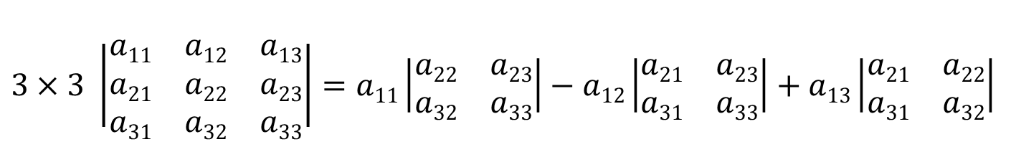
Determinants
The determinant D=|A| of a matrix is formed from the coefficients of [A].
Determinants for small matrices are:
$$1×1 \left|a11\right|=a11$$
$$2×2 \left|\begin{matrix}a11 & a12 \\ a21 & a22\end{matrix}\right|=a11a22−a12a21$$
$$3×3 \left|\begin{matrix}a11 & a12 & a13 \\ a21 & a22 & a23 \\ a31 & a32 & a33\end{matrix}\right|=a11\left|\begin{matrix}a22 & a23 \\ a32 & a33\end{matrix}\right|−a12\left|\begin{matrix}a21 & a23 \\ a31 & a33\end{matrix}\right|+a13\left|\begin{matrix}a21 & a22 \\ a31 & a32\end{matrix}\right|$$
Determinants for matrices larger than 3 x 3 can be very complicated.

Slide 6
Cramer’s Rule
Cramer’s Rule states that each unknown in a system of linear algebraic equations may be expressed as a fraction of two determinants with denominator D and with the numerator obtained from D by replacing the column of coefficients of the unknown in question by the constants b₁, b₂, …, b_{n}.

Slide 7
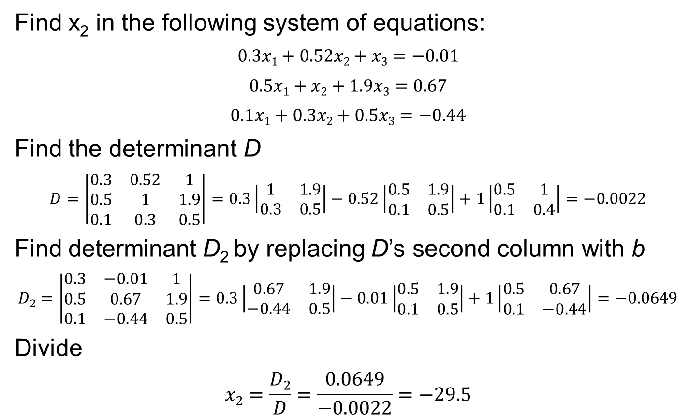
Cramer’s Rule Example
Find x₂ in the following system of equations:
$$0.3x1+0.52x2+x3=−0.01$$
$$0.5x1+x2+1.9x3=0.67$$
$$0.1x1+0.3x2+0.5x3=−0.44$$
Find the determinant D
$$D=\left|\begin{matrix}0.3 & 0.52 & 1 \\ 0.5 & 1 & 1.9 \\ 0.1 & 0.3 & 0.5\end{matrix}\right|=0.3\left|\begin{matrix}1 & 1.9 \\ 0.3 & 0.5\end{matrix}\right|−0.52\left|\begin{matrix}0.5 & 1.9 \\ 0.1 & 0.5\end{matrix}\right|+1\left|\begin{matrix}0.5 & 1 \\ 0.1 & 0.4\end{matrix}\right|=−0.0022$$
Find determinant D₂ by replacing D’s second column with b
$$D2=\left|\begin{matrix}0.3 & −0.01 & 1 \\ 0.5 & 0.67 & 1.9 \\ 0.1 & −0.44 & 0.5\end{matrix}\right|=0.3\left|\begin{matrix}0.67 & 1.9 \\ −0.44 & 0.5\end{matrix}\right|−0.01\left|\begin{matrix}0.5 & 1.9 \\ 0.1 & 0.5\end{matrix}\right|+1\left|\begin{matrix}0.5 & 0.67 \\ 0.1 & −0.44\end{matrix}\right|=−0.0649$$
Divide
$$x2=\frac{D2}{D}=\frac{0.0649}{−0.0022}=−29.5$$

Slide 8
Naïve Gauss Elimination, 1
For larger systems, Cramer’s Rule can become unwieldy.
Instead, a sequential process of removing unknowns from equations using forward elimination followed by back substitution may be used—this is Gauss elimination.
“Naïve” Gauss elimination simply means the process does not check for potential problems resulting from division by zero.

Slide 9
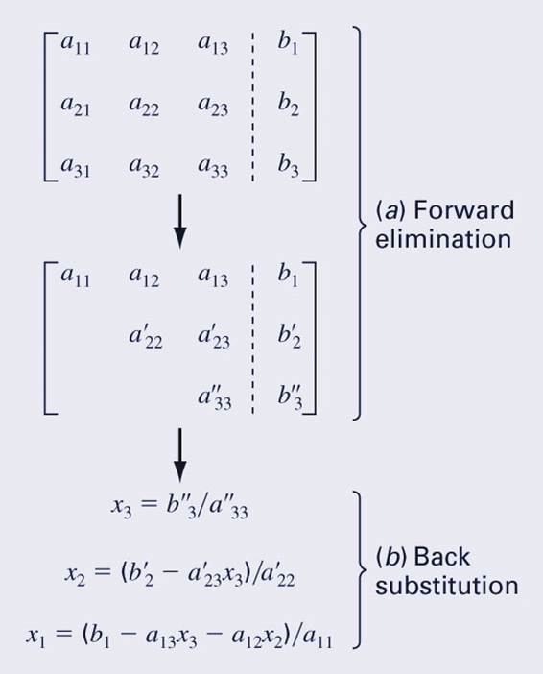
Naïve Gauss Elimination, 2
Forward elimination
Starting with the first row, add or subtract multiples of that row to eliminate the first coefficient from the second row and beyond.
Continue this process with the second row to remove the second coefficient from the third row and beyond.
Stop when an upper triangular matrix remains.
Back substitution
Starting with the last row, solve for the unknown, then substitute that value into the next highest row.
Because of the upper-triangular nature of the matrix, each row will contain only one more unknown.

Slide 10
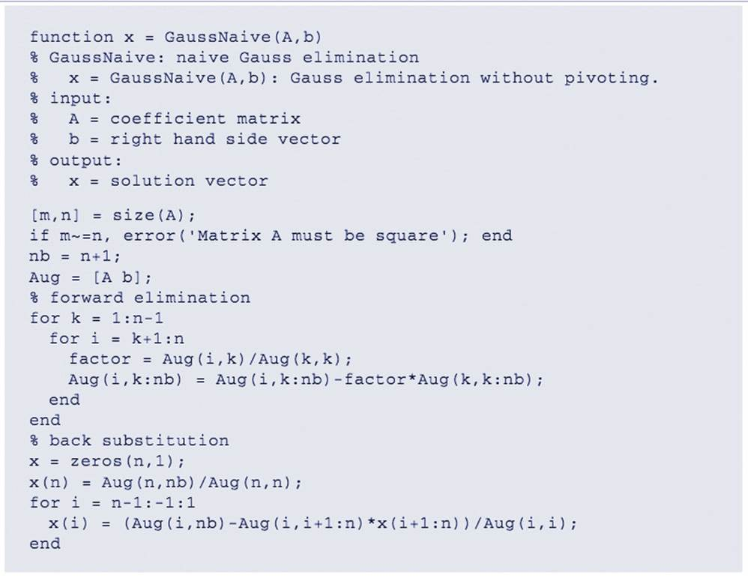
Naïve Gauss Elimination Program

Slide 11
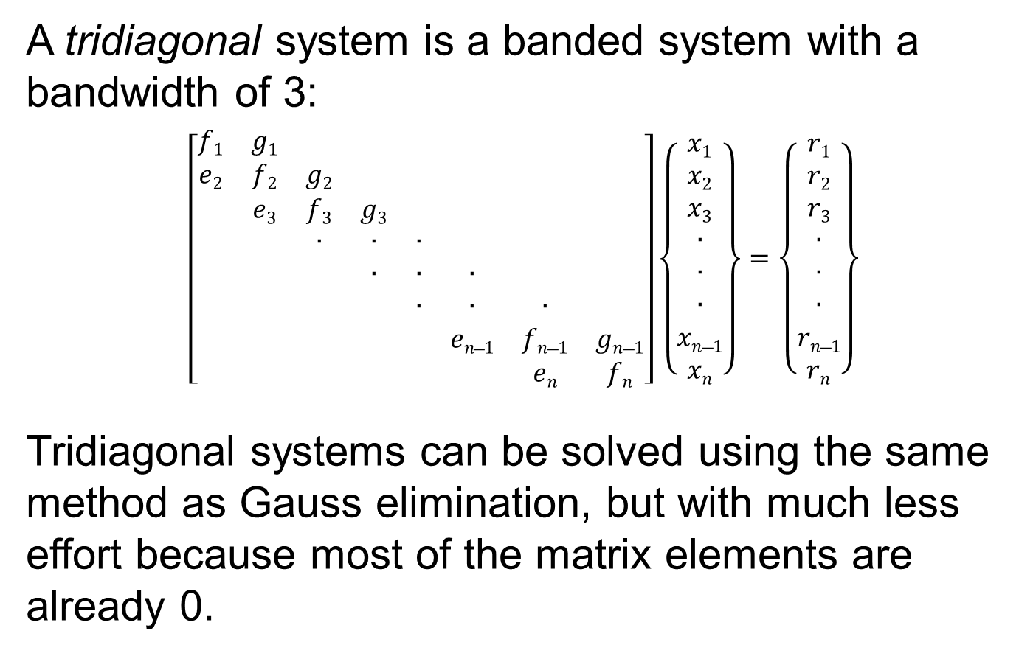
Tridiagonal Systems
A tridiagonal system is a banded system with a bandwidth of 3:
$$\left[\begin{matrix}f1 & g1 & & & & & & \\ e2 & f2 & g2 & & & & & \\ & e3 & f3 & g3 & & & & \\ & & ∙ & ∙ & ∙ & & & \\ & & & ∙ & ∙ & ∙ & & \\ & & & & ∙ & ∙ & ∙ & \\ & & & & & en−1 & fn−1 & gn−1 \\ & & & & & & en & fn\end{matrix}\right]\left\{\begin{matrix}x1 \\ x2 \\ x3 \\ ∙ \\ ∙ \\ ∙ \\ xn−1 \\ xn\end{matrix}\right\}=\left\{\begin{matrix}r1 \\ r2 \\ r3 \\ ∙ \\ ∙ \\ ∙ \\ rn−1 \\ rn\end{matrix}\right\}$$
Tridiagonal systems can be solved using the same method as Gauss elimination, but with much less effort because most of the matrix elements are already 0.

Slide 12
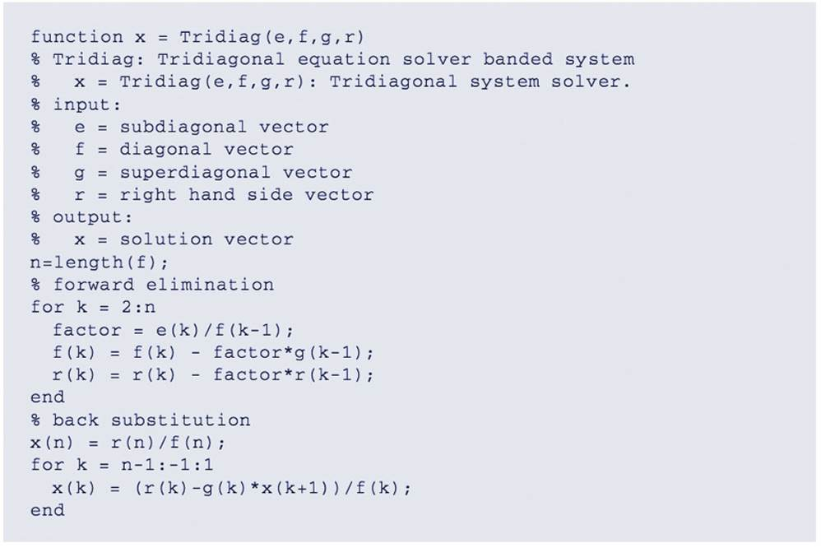
Tridiagonal System Solver

Slide 13
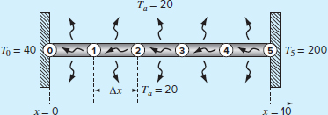
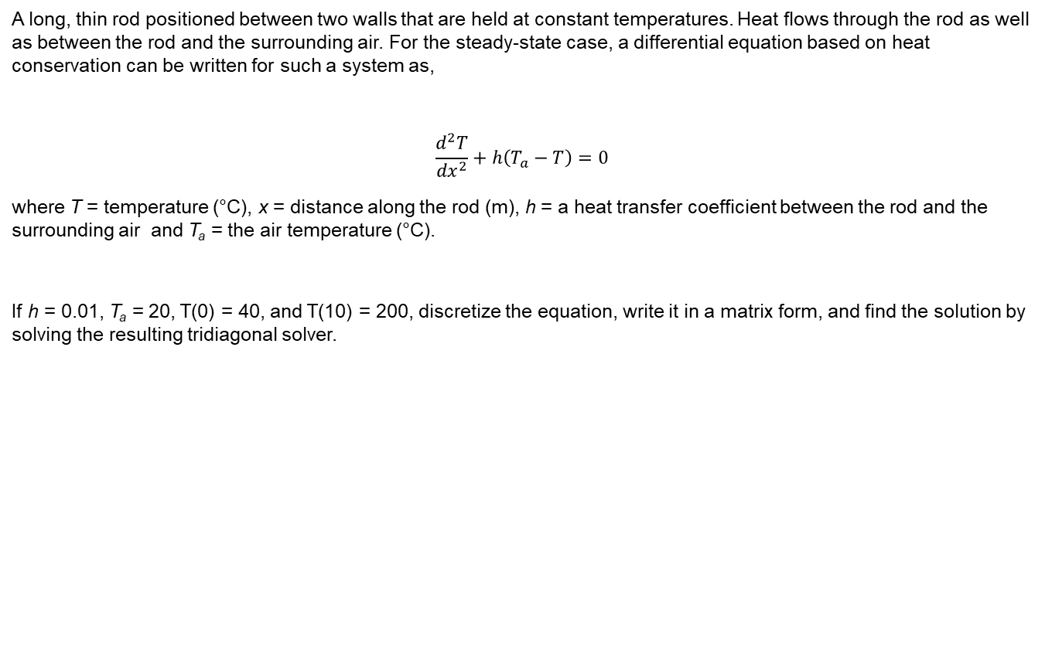
Tridiagonal System Solver Case study 9.5
A long, thin rod positioned between two walls that are held at constant temperatures. Heat flows through the rod as well as between the rod and the surrounding air. For the steady-state case, a differential equation based on heat conservation can be written for such a system as,
$$\frac{d^{2}T}{{dx}^{2}}+h\left(T_{a}−T\right)=0$$
where T = temperature (°C), x = distance along the rod (m), h = a heat transfer coefficient between the rod and the surrounding air and T_{a} = the air temperature (°C).
If h = 0.01, T_{a} = 20, T(0) = 40, and T(10) = 200, discretize the equation, write it in a matrix form, and find the solution by solving the resulting tridiagonal solver.

Slide 14
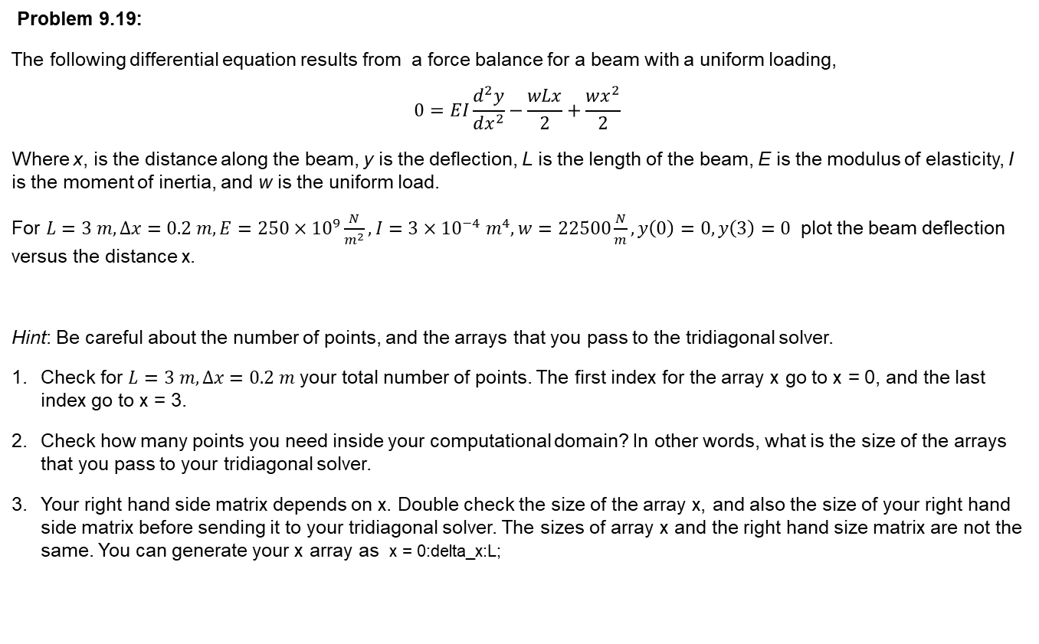
Tridiagonal System Solver
Problem 9.19:
The following differential equation results from a force balance for a beam with a uniform loading,
$$0=EI\frac{d^{2}y}{dx^{2}}−\frac{wLx}{2}+\frac{wx^{2}}{2}$$
Where x, is the distance along the beam, y is the deflection, L is the length of the beam, E is the modulus of elasticity, I is the moment of inertia, and w is the uniform load.
For $L=3 m, ∆x=0.2 m, E=250×{10}^{9}\frac{N}{m^{2}}, I=3×{10}^{−4} m^{4},w=22500\frac{N}{m}, y\left(0\right)=0, y\left(3\right)=0$ plot the beam deflection versus the distance x.
Hint: Be careful about the number of points, and the arrays that you pass to the tridiagonal solver.
Check for $L=3 m, ∆x=0.2 m$ your total number of points. The first index for the array x go to x = 0, and the last index go to x = 3.
Check how many points you need inside your computational domain? In other words, what is the size of the arrays that you pass to your tridiagonal solver.
Your right hand side matrix depends on x. Double check the size of the array x, and also the size of your right hand side matrix before sending it to your tridiagonal solver. The sizes of array x and the right hand size matrix are not the same. You can generate your x array as x = 0:delta_x:L;

Slide 15
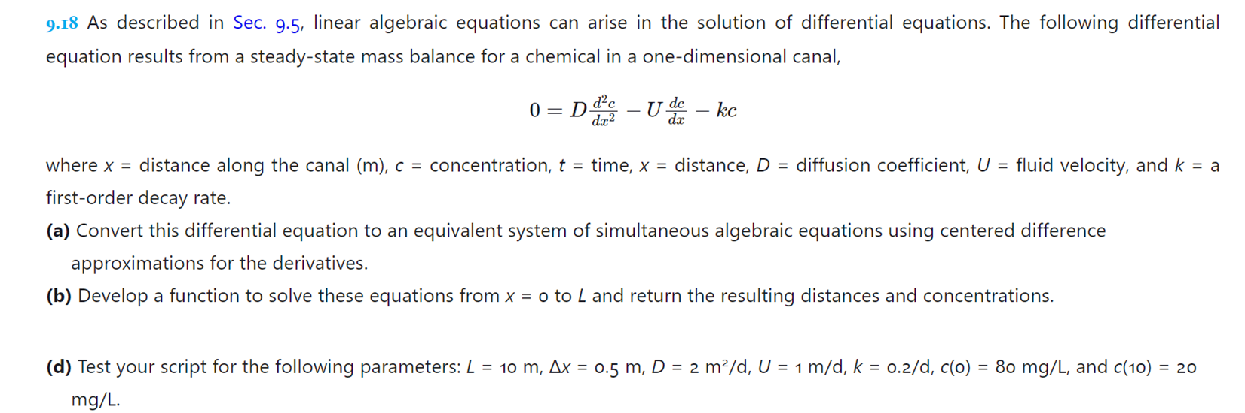
Tridiagonal System Solver

